Slide 1

Energy consumption prediction in households
RESEARCH WORK

Slide 2
AGENDA
INTRODUCTION
DATA PREPROCESSING
EXPLORATORY DATA ANALYSIS
FEATURE ENGINEERING
MODEL BUILDING
MODEL EVALUATION
HYPERPARAMETER TUNING
SUGGESTION
CONCLUSION

Slide 3
INTRODUCTION
This projects focuses on the objective to predict the energy consumption in households.
Using different machine learning models were used to predict
Important feature engineering, exploratory data analysis is used.
Energy csv file is the resource used
The project is deployed on Streamlit

Slide 4
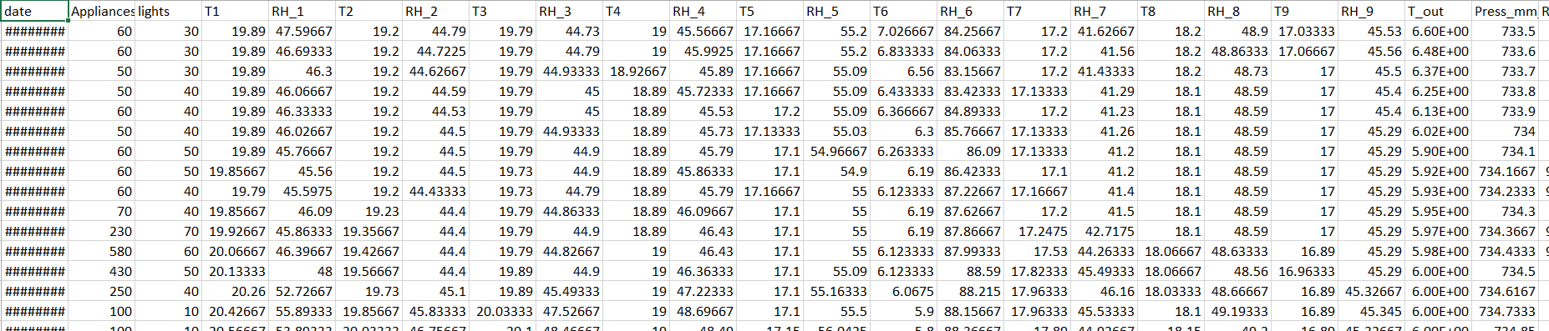
Data of the ENERGY.Csv file
Data consists of date ,temperature of different area of house and outside ,similarly the humidity

Slide 5
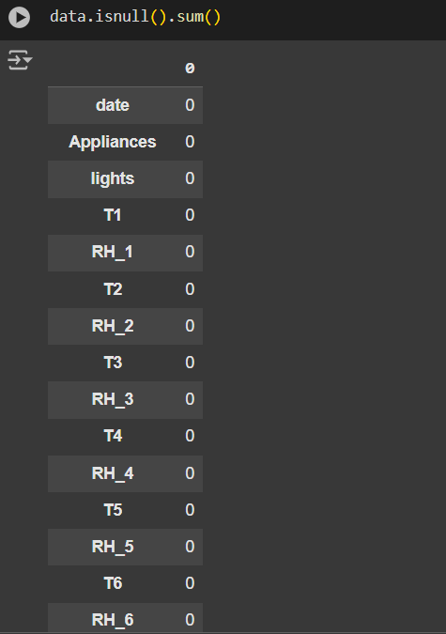
DATA PREPROCESSING
Data preprocessing is the process of cleaning, transforming, and organizing raw data into a suitable format for machine learning models. It involves steps like handling missing values, removing outliers, feature scaling, encoding categorical variables, and feature engineering.
Importance:1. Improves Model Performance: Ensures that the data is clean and well-structured, enabling the model to learn patterns effectively.
2. Handles Data Issues: Resolves inconsistencies like missing values, outliers, and noisy data that can distort predictions.
3. Ensures Compatibility: Transforms raw data into formats compatible with machine learning algorithms (e.g., numerical encoding).
4. Enhances Interpretability: Simplifies the data, making patterns and relationships clearer.

Slide 6
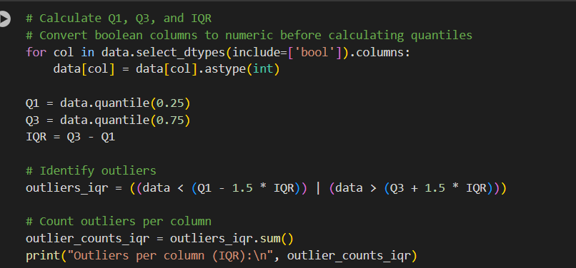
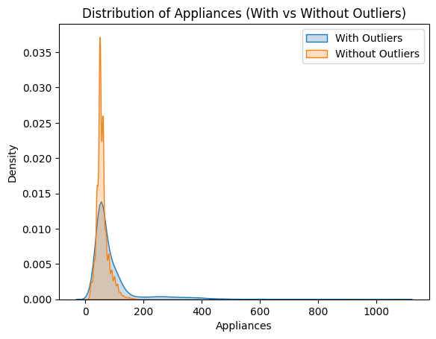
HANDLING OUTLINERS
Handling outliers is critical for building robust, reliable, and interpretable machine learning models. Whether through removal, transformation, or separate analysis, addressing outliers ensures that the model’s performance and insights are accurate and meaningful.

Slide 7
EXPLORATARY DATA ANALYSIS
Exploratory Data Analysis (EDA) is a crucial initial step in data science projects. It involves analyzing and visualizing data to understand its key characteristics, uncover patterns, and identify relationships between variables refers to the method of studying and exploring record sets to apprehend their predominant traits, discover patterns, locate outliers, and identify relationships between variables. EDA is normally carried out as a preliminary step before undertaking extra formal statistical analyses or modeling.

Slide 8
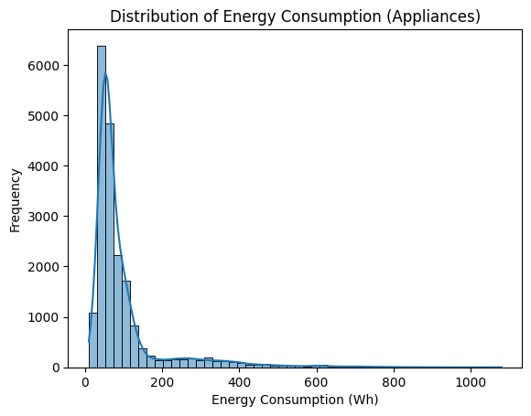
Distribution of Energy Consumption

Slide 9
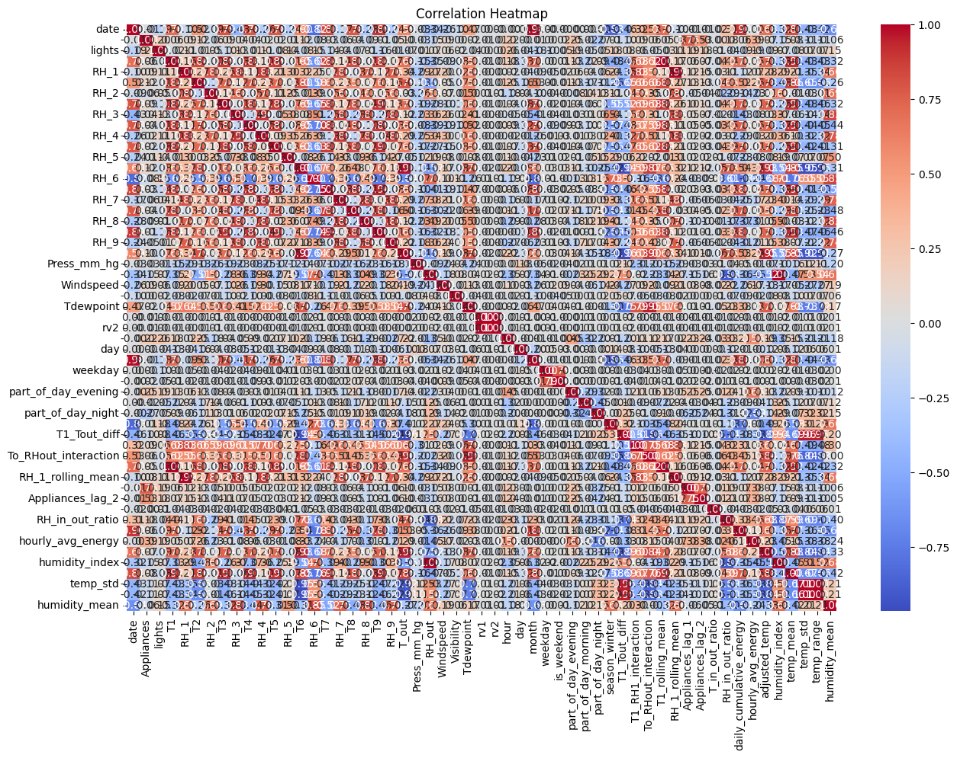
Correlation map
EXPLAINS THE CORRELATION BETWEEN VARIABLES

Slide 10
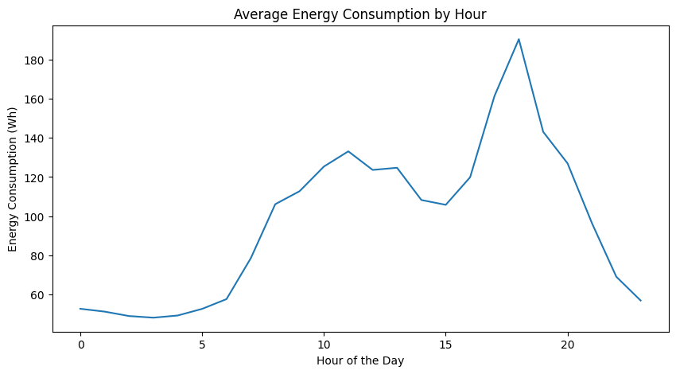
Average Energy Consumption by Hour

Slide 11
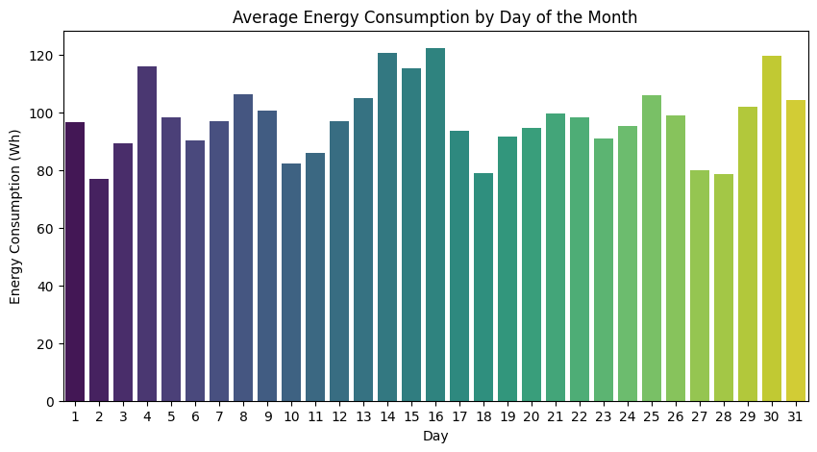
Average Energy Consumption by day of the month

Slide 12
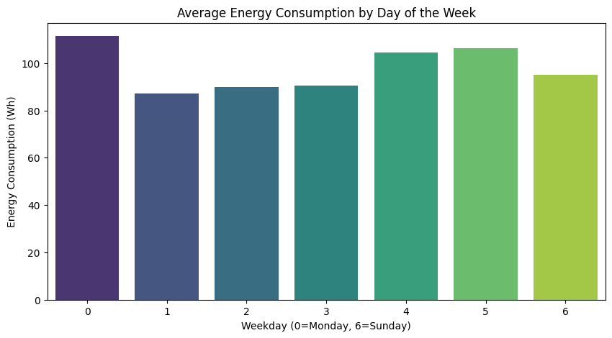
Average Energy consumption by the day of the week

Slide 13
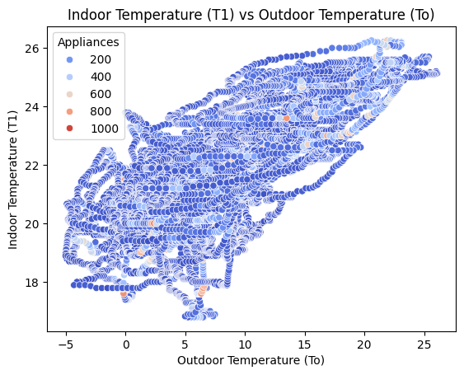
Indoor Vs Outdoor Temperature

Slide 14
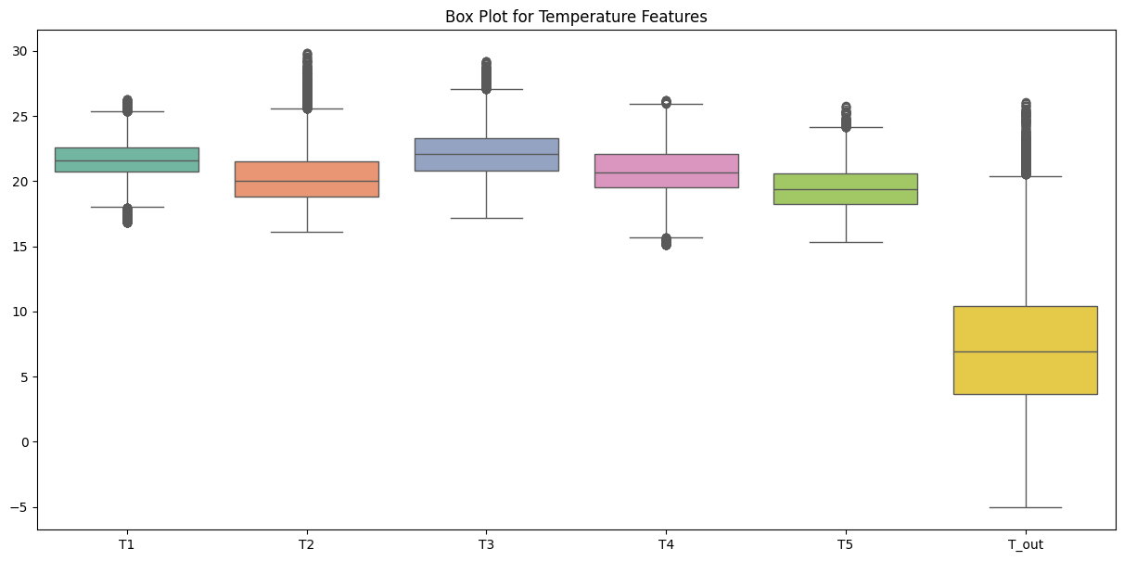
Temperature

Slide 15
Feature engineering
Feature engineering involves creating, transforming, and selecting features from the raw dataset to improve the model's performance and ensure consistency during training and prediction. Here's an explanation of the key feature engineering steps used in this project:--
1. Feature Scaling (Normalization/Standardization): ?Features such as temperature, humidity, and energy usage were standardized using StandardScaler (scaling the data to have a mean of 0 and standard deviation of 1).Why?Features often have different ranges (e.g., temperature in °C vs. energy in kWh). Scaling ensures that no feature dominates others during training.Random Forest does not require scaling for splitting, but it’s necessary for preprocessing consistency, especially when using other algorithms or pipelines.
-2. Lag Features for Time-Series Data: Lag features (Appliances_lag_1, Appliances_lag_2) were created from the Appliances column (energy consumption).Appliances_lag_1 represents the previous hour's energy consumption.Appliances_lag_2 represents the energy consumption two hours prior.Why?Energy consumption at any time is heavily dependent on past consumption trends (e.g., peak hours or high usage periods).Lag features help the model learn temporal dependencies in the data.
3. Rolling Mean Features A rolling mean (e.g., RH_1_rolling_mean) was calculated for humidity (RH_1).A window of 3 hours was used to calculate the rolling average.Why?Rolling means smooth out short-term fluctuations and capture trends over time.For example, a sudden drop in humidity may not significantly impact energy usage, but sustained low humidity over a few hours might.

Slide 16
4. Feature Ratios :Ratios such as RH_in_out_ratio (indoor vs. outdoor humidity) were calculated.RH_in_out_ratio = RH_1 / RH_out.Ratios provide insights into the relationship between indoor and outdoor conditions, which can significantly influence energy consumption (e.g., HVAC systems work harder when there’s a large indoor-outdoor difference).-
5. Feature Selection:What was done?Only the most relevant features (e.g., temperature, humidity, past energy consumption) were included in the model, excluding redundant or unimportant features.Reducing the number of features improves model interpretability and training efficiency.Irrelevant features can introduce noise and degrade the model's performance.
6. Handling Outliers:Outliers in features such as temperature or energy consumption were detected using statistical methods (e.g., IQR or Z-score).Outliers were handled using imputation or transformation methods.Extreme values can distort the model’s training process.For example, an unusually high energy consumption value may result from a one-time event and should not influence general predictions.
7. Handling Missing :Missing values in features like temperature or humidity were imputed using their mean, median, or forward-fill method.Why?Missing values disrupt the training process. Imputation ensures the data remains usable without dropping rows unnecessarily.

Slide 17
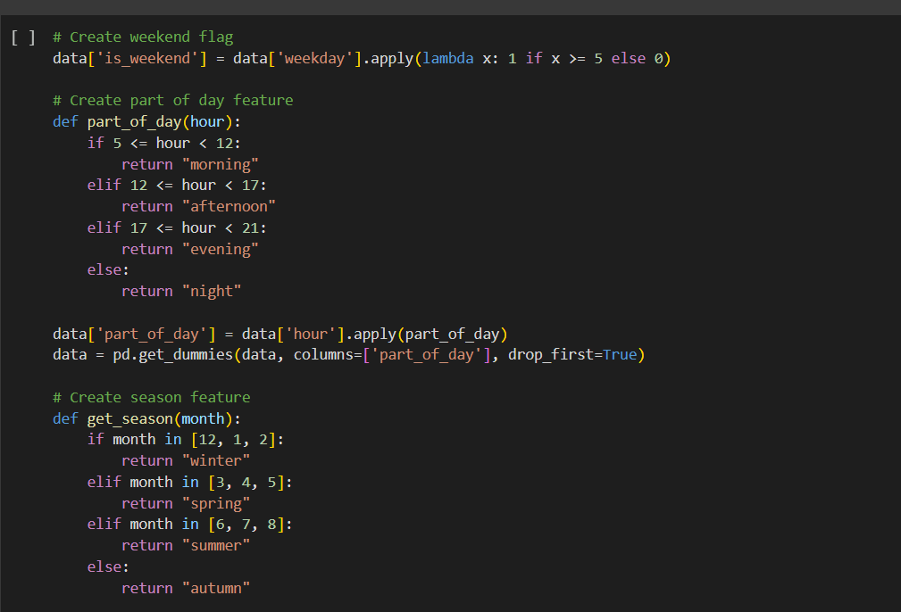
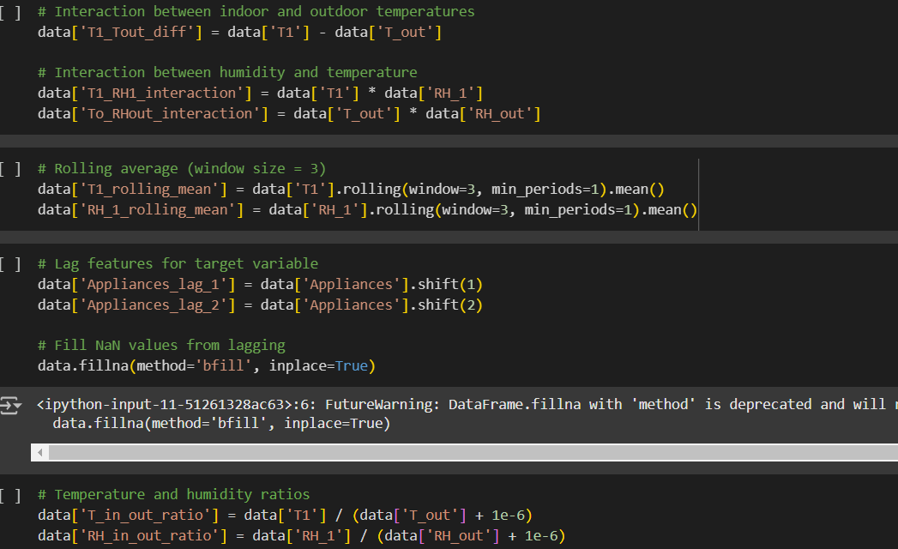

Slide 18
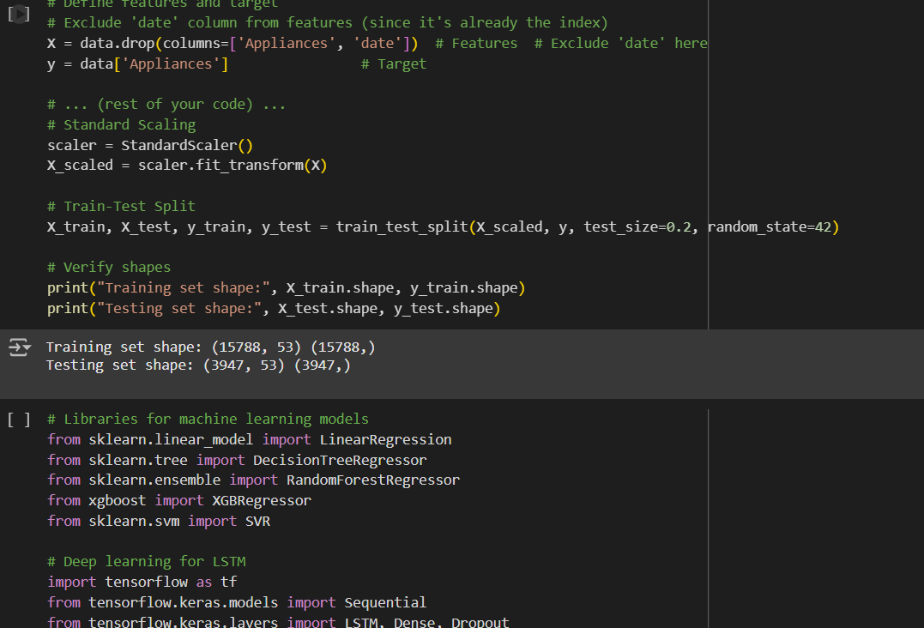
MODEL BUILDING
SPLITTING AND SCALING THE DATA FOR MODEL BUILDING
Models used where random forest,linear regression,lstm,arima,sarima,xgboost,ADABOOST,decision tree,knn,svr

Slide 19
EVALUATION
Models | MAE | MSE | R^2
Linear regression | 30.28 | 63.2 | 0.60
Decision tree | 31.55 | 77.7 | 0.39
Random forest | 27.08 | 60.1 | 0.63
XB Boost | 28.43 | 62.21 | 0.61
SVR | 27.09 | 67.44 | 0.54
LSTM | 34.31 | 70.27 | 0.50
ARIMA | 57.76 | 91.44 | -0.010
SARIMA | 58.52 | 91.74 | -0.016
Adaboost | 101.58 | 111.074 | -0.233
knn | 30.891 | 68.23 | 0.515

Slide 20
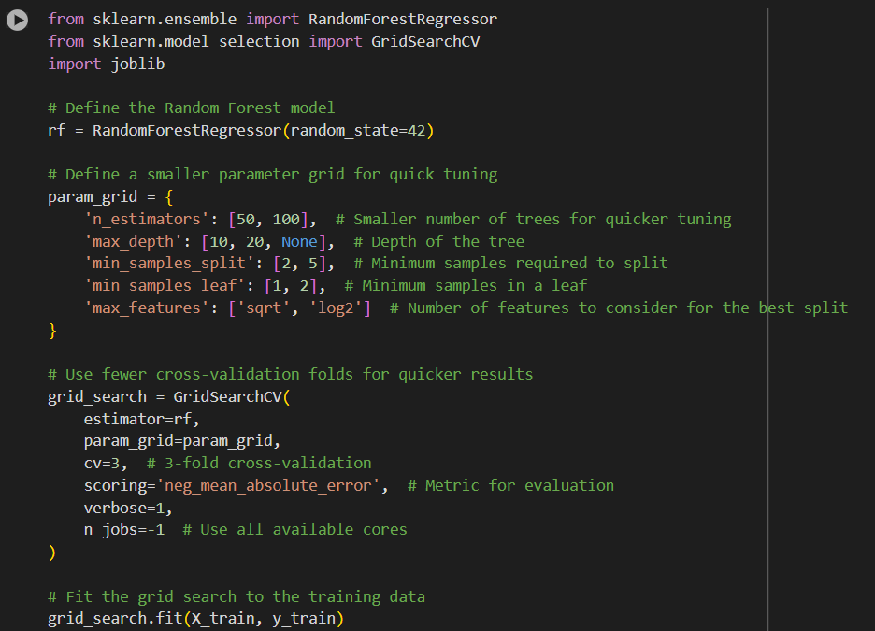
HYPERPARAMETER TUNING
HYPERPARAMETER TUNE IS DONE TO RANDOM FOREST AS THE MODEL PERFORMS BETTER COMPARED TO OTHER MODELS

Slide 21
INTERPRETATION
Best Performing Model:○ Random Forest achieved the bestperformance with:‣ Lowest MAE (27.089)‣ Highest R (0.639)2.
XGBoost was the second-best model,with comparable results to RandomForest.‣ Lowest RMSE (60.111)
3. SVR performed well but had a higherRMSE than Random Forest andXG Boost.
4. Time-Series Models (ARIMA &SARIMA) underperformed due to theirinability to fully leverage all features,especially static features liketemperature and humidity.
5. AdaBoost struggled with this datasetdue to its sensitivity to outliers andnoise.
6. KNN performed moderately but iscomputationally expensive for largedatasets.
7. LSTM: Despite being designed forsequential data, it was less effectivehere due to the relatively small datasetsize and complexity in hyperparametertuning

Slide 22
Findings
1. Cost ManagementAccurate energy consumption predictions allow households and businesses to manage their energy costs effectively:Real-Time Monitoring:The model predicts energy consumption based on real-time data, allowing users to understand their usage patterns and identify appliances consuming excessive energy.Customized Recommendations:With insights from the model, users can receive actionable recommendations, such as:Scheduling high-energy appliances during off-peak hours for reduced tariffs.Upgrading or repairing inefficient appliances.Energy-Saving Plans:Service providers can offer dynamic pricing plans or discounts tailored to customers' specific consumption behaviors.
2. Energy OptimizationEnergy optimization ensures minimal wastage while meeting household or industrial requirements:Peak Load Distribution:By analyzing temperature, humidity, and appliance usage, the model identifies periods of excessive energy demand.Users can schedule appliances to optimize energy usage across the day.
Integration with Renewable Energy:Predictions can help households prioritize renewable energy sources (like solar or wind) during optimal conditions, reducing dependency on conventional sources.Smart Automation Systems:Integration with IoT devices allows automation of energy usage based on predicted consumption (e.g., turning off unused appliances or optimizing HVAC systems).
3. Grid ManagementEffective grid management is crucial for utility providers to maintain a stable and efficient energy supply:Load Forecasting for Utilities:Aggregating predictions across households helps utility companies anticipate energy demand and avoid overloading the grid.Reduction of Peak Loads:Utilities can design demand-response strategies, such as incentivizing users to reduce consumption during peak hours.Planning Infrastructure Upgrades:Detailed insights into regional energy consumption trends can guide grid expansions, infrastructure upgrades, and maintenance schedules.Outage Prevention:Predicting demand fluctuations helps utilities proactively address potential overloads or outages, ensuring reliability.

Slide 23
CONCLUSION
This project demonstrates the successful development and deployment of a robust machine learning model to predict household appliance energy consumption accurately. By leveraging advanced feature engineering, a diverse set of machine learning algorithms, and deployment strategies.

